Slide 1
The Heights Community School Title I Annual Meeting
Thursday, Sept 3, 2020
Welcome Heights Families!

Slide 2
What is Title I?
United States Federal Government’s largest education program to support public schools.
The Purpose:
To help every child receive a high quality education and to achieve the high academic standards set by the State of Minnesota.

Slide 3
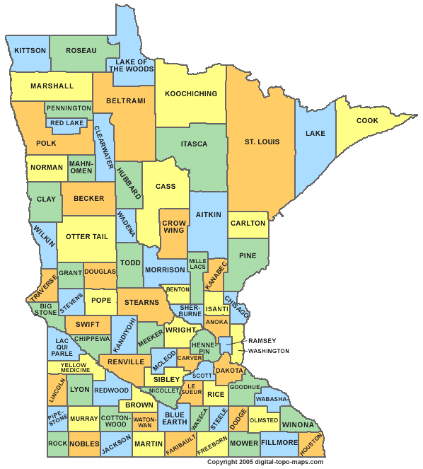
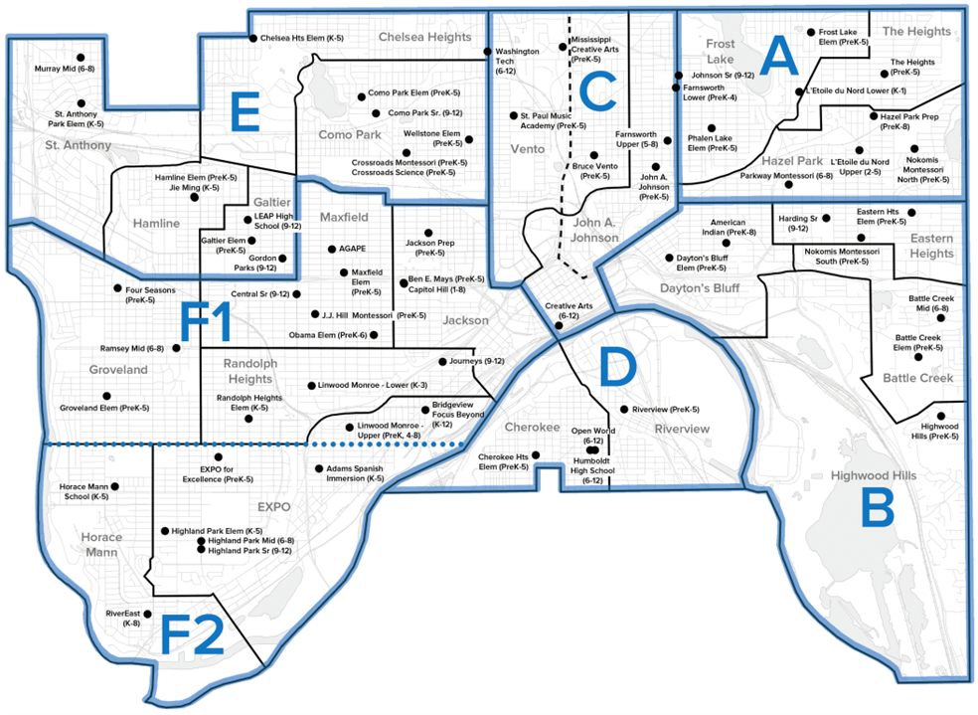
How is Title I funded?
Title I funds flow from the U.S. Department of Education to the Minnesota Department of Education (MDE). Then to the school district based on poverty data.
The district allocates Title I funds to schools based on the percentage of students receiving free or reduced lunch.

Slide 4
Eligible Schools in 2020-2021
54 elementary, secondary and alternative schools in Saint Paul receive Title I funds.
Schools with a concentration 40% or more of the students eligible to receive free or reduced priced lunch receive Title I funding. This percentage can change each year.

Slide 5
Title I in the Schools
Each school decides how Title I funds will be used in their school to improve education for all children.
Data is reviewed to determine the greatest need for improvement in the school.
The school staff, with the input of parents, develops a school improvement plan with specific strategies to improve student achievement across the school.
Teachers, administrators and parents work together to prioritize how Title I funds will be used to support the school’s strategies to improve education for all students.

Slide 6
Our School Continuous Improvement Plan
Our school continuous improvement strategies are:
–Reading
–Math
–Culture Climate
Strategies are listed in the SCIP at a Glance
At The Heights we use Title I funds to support our SCIP strategies by funding staff positions such as a Parent Liaison, Learning Lead and Behavior Intervention Specialist.
SCIPs are continuously monitored, reviewed and revised based implementation and student data. Input from parents in that process is valuable.
Notes:
Title I funds may be used for activities and strategies designed to raise the achievement of low-achieving students identified by a school’s needs assessment and articulated in the school’s comprehensive schoolwide plan or in SPPS the School Continuous Improvement Plan (SCIP).
Q: How does your school continuous improvement plan address these three components?
Meeting the educational needs of historically underserved populations; and
Addressing the needs of all students but particularly the needs of low-achieving students and those at risk of not meeting the State’s standards who are members of the target population of any program included in the schoolwide plan.
A schoolwide program must provide effective, timely additional assistance to students who experience difficulty mastering the State’s academic achievement standards.

Slide 7
What programs/supports are in place to help my child?
Strategies implemented in the school improvement plan are listed in the SCIP at a Glance and include:
Reading:
•Differentiating small group instruction in reading
•Co-Teaching with SpecEd and MLL teachers
•Conferring with students
•Teacher providing data driven phonics instruction
Math:
•Personalizing each student’s math learning
•Providing specific language supports to help with accurate math vocabulary
•Enhancing student’s number skills and computational skills
•Teaching math facts in a variety of ways
Culture Climate
•Daily Morning Meeting and Closing Circle
•Innocent Classroom strategies
•Zones of Regulation
•PBIS Team will review classroom procedures, feedback systems and discipline policies on a monthly basis
Link to SCIP and SCIP at A Glance on our website:
https://www.spps.org/domain/3785

Slide 8
Involving Parents in Title I Schools
Parents and teachers working together to support each student’s learning is powerful.
Schools are required to plan how they will involve parents in the education of their children. Here is how!
Family Engagement Plan
School Compact

Slide 9
Working Together in Partnership!
The Family Engagement Plan is developed, revised, and evaluated with families each year.
The plan describes how schools will:
reach out to parents, and
work with and support parents in their child’s education.
The 2020-21 Family Engagement Plan is available at Family Events, on the website, in the office and in the Parent Room.
Please attend (on-line or in-house) the spring 2021 PTA, Budget and Year in Review meetings to review, discuss, evaluate and finalize for 2021-22!

Slide 10
Working together in partnership!
Schools and parents must also work together to develop a Compact. The compact describes how the school and parents will work together to support students’ learning.
The compact is discussed and passed out at November conferences. It is available available at Family Events, on the website, in the office and in the Parent Room.
The draft of the 2020-21 Compact is available on our webpage: https://www.spps.org/domain/3785
Please attend (on-line or in-house) the spring 2021 PTA, Budget and Year in Review meetings to review, discuss, evaluate and finalize for 2021-22!

Slide 11
How does Title I support families?
Parents can help decide how our school uses
our parent engagement funds: Here are some
ways funds can be used to support families.
Remove barriers so all parents can participate!
Provide translations and interpreters during school meetings and educational activities.
Provide child care.
Hire a parent liaison to help facilitate parent engagement activities and support parents.
Provide support to parents:
Offer parenting classes for parents.
Host activities to assist parents in helping their children learn.
Provide classes to support parents knowledge (family literacy, English, etc.)
Please attend (on-line or in-house) the spring 2021 PTA, Budget and Year in Review meetings to review, discuss, evaluate and finalize for 2021-22!

Slide 12
School Improvement Designation
Every three years the state identifies schools in need of improvement. Our designation is:
Targeted Support and Improvement (TSI)
To find out more about the reporting system visit the Identification Process page on the Minnesota Department of Education website.
Notes:
Spend some time discussing your specific designation with families:
CSI schools are the lowest-performing five percent of Title I schools in the State or any public high school in the state with a four year graduation rate at or below 67 percent.
TSI schools have one or more student group(s) consistently underperforming or one or more student group(s) performing at or below the level of students at CSI schools.
Schools designated as CSI or TSI will receive support from our district’s school improvement team.

Slide 13
Curriculum Used at Our School
Mathematic Expectations - Minnesota State Standards https://drive.google.com/file/d/0BzNfqkDAgefjRGRwcTczQWI3QUU/view
Elementary - https://www.spps.org/Page/24143
Secondary - https://www.spps.org/Page/21740
Literacy Expectations – Minnesota State Standards https://drive.google.com/file/d/0B3l44M1fEAkGRUc0SXcyZFpralk/view
Literacy Plan - https://drive.google.com/file/d/0B3l44M1fEAkGcWhtREJhVW54Szg/view
Dual Language https://www.spps.org/Domain/10455
A one page family friendly Curriculum standards for each grade level are available upon request. If interested, contact Julie Welman at julie.wellman@spps.org

Slide 14
Assessments at Our School
Assessments used at The Heights included MCA, FAST, ACCESS for ELL, PreK Literacy, PreK Math, ACT, MTAS, CogAT7,
Find the link to the district test calendar on our website at https://www.spps.org/Page/21430
Other examples include: formative assessments, running records, work sampling, unit tests, etc.

Slide 15
Parents have the right…
Request information about the qualifications of your child’s teacher.
Be notified if your child is being taught for more than four consecutive weeks by a teacher not licensed in the area of instruction.
To receive progress reports for your child and the school.
Assessment results
Progress reports
Report cards
Reports as requested
Help decide if the school is meeting your child’s needs and offer suggestions for improvement.
Link to Parent Right to Know documentation on our website:
https://www.spps.org/domain/3785
Notes:
Your Right to Know Notices
ESEA directs schools and districts to notify parents about four key requirements of a Title I, Part A program.
1. Professional qualifications of teachers and paraprofessionals who instruct
2. Notification if your child’s teacher is not highly qualified
3. Individual report card that lets you know how your child is progressing
4. Notification that the school has entered school improvement status.
Your Right to Know —Professional Qualifications of Teachers
Parents of children, who attend schools that receive Title I, Part A funding, have the right to request and receive information about the qualifications of the educators who teach their children in the core subjects. The same applies to paraprofessionals who instruct.
At a minimum, the information you receive must provide information on these 3 essential components of an educator’s qualifications.
Whether or not the teacher met state qualifications and certification requirements for the grade level and subject(s) he or she is teaching,
Whether or not the teacher has an emergency or conditional certificate by which state qualifications were waived.
What undergraduate and graduate degree(s) the teacher holds, including graduate certificates and additional degrees, and major(s) or area(s) of concentration.
Your Right to Know—Qualifications of Paraprofessionals Who Instruct
You have the right to know and request information about Paraprofessionals who instruct in a Schoolwide Title 1 school including paraprofessionals supporting students receiving special education services.
Paraprofessionals who work in a Title I program must meet federal qualification requirements.
All paraprofessionals who work in the Title I program must have a high school diploma or its equivalent.
Paraprofessionals who assist with instruction must meet additional requirements in one of three ways:
Option A: Completed at least two years of study at an institution of higher education (a minimum of 60 semester credits or the amount required to complete two years of full-time enrollment as defined by the institution attended); or
Option B: Obtained an associate's (or higher) degree; or
Option C: Demonstrate, through a formal state or local academic assessment, knowledge of and the ability to assist in instructing, reading, writing, and mathematics (or, as appropriate, readiness for each of these subject areas). This third option is usually accomplished by obtaining a minimum score of 460 on the ParaPro test.
Your Right to Know —Notification If Your Child’s Teacher Is Not Licensed
ESEA directs schools to send timely notice to parents and guardians IF their child has been assigned to, or taught
for more than four consecutive weeks by—a teacher of a core academic subject—who is not appropriately licensed to teach the grade and/or subject area.

Slide 16
How are Title I resources used at our school?
Title I resources are used at The Heights to fund a Parent Liaison, a Behavior Intervention Specialist, a GT Specialist and a Learning Lead.
Title I resources are also used to provide transportation to academic events.
Notes:
Review the funding that you receive and how you use those fund in your building.

Slide 17
Families are an important part of the educational team
Working together in partnership, what can our school do to support you as you support your child’s learning?

Slide 18
Families are an important part of the educational team
Ways you can support your child’s learning:
Get to know your child’s teacher(s).
Contact the school when you have questions or concerns.
Learn what is expected of your child at each grade level and help your child follow through with school expectations.

Slide 19
Families are an important part of the educational team
Become involved in your school’s meetings and activities and know your rights as a parents.
Work with other families and teachers to revise your school plan (SCIP) and Family Engagement Plan.
Attend your children’s school conferences and family activities designed to help your children succeed.

Slide 20
For More Information About Title I
Call the Title I Office
651-632-3790
Or
Talk to your school’s principal or parent liaison.

